Slide 1

E-commerce recommendation system using ML
Presenters: Surya pratap singh, utkarsh mishra, adrika tripathi

Slide 2
PROBLEM STATEMENT
In the e - commerce recommendation system there is problem of accuracy as the recommended products are not always relevant. And also the problem of cold start (for the new user having less data) and the gray sheep problem in which the user choices are not matching with any major group items or users.

Slide 3
OBJECTIVE
The main objective of our project is to increase the accuracy of the e-commerce recommendation system and also will work on the precision of the set of data for finding better results.

Slide 4
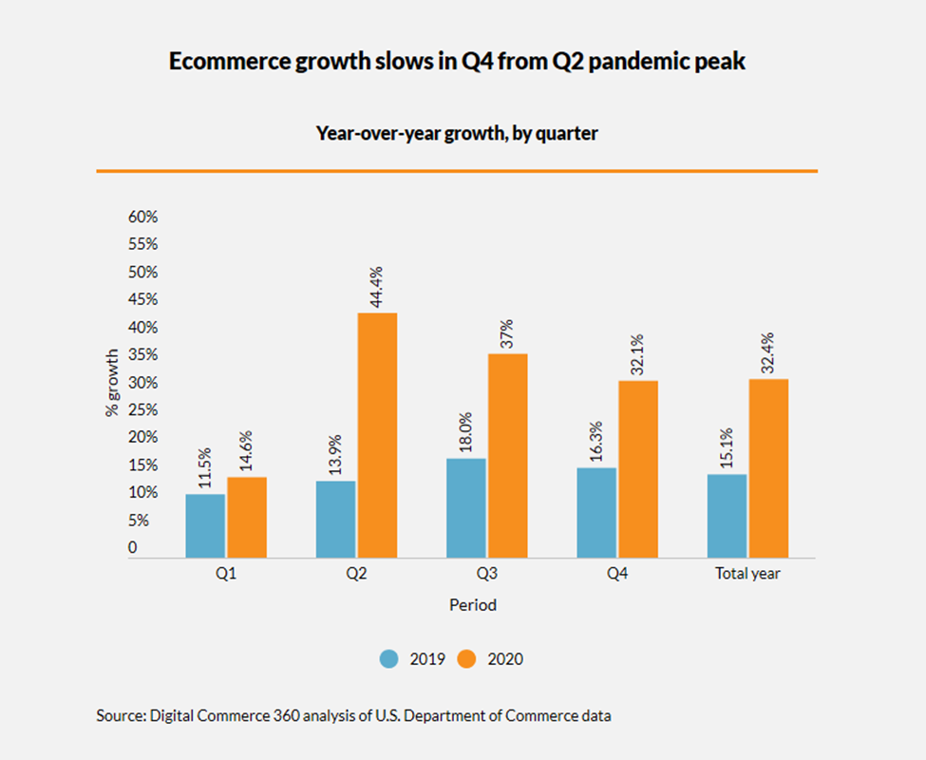
Previous data
In the below bar graph, we can clearly see that the sales rate increased from 15.1% to 32.4% over the year 2019 to 2020 using the recommendation system.

Slide 5
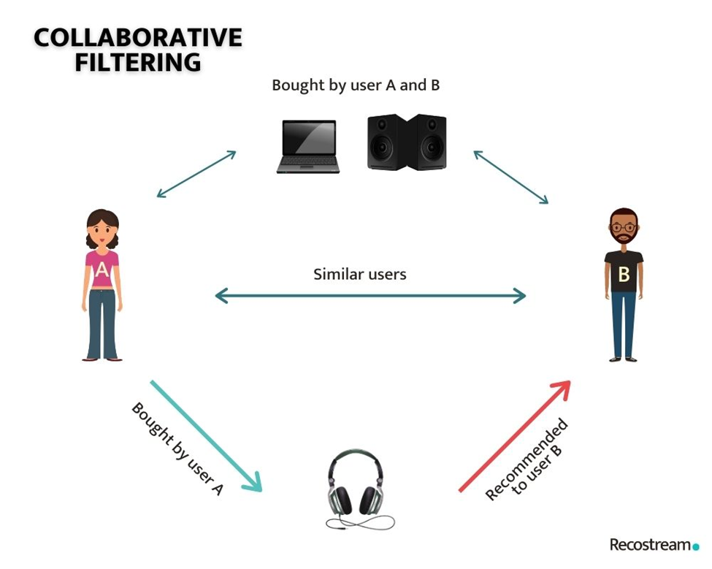
Algorithm used

Slide 6
Algorithm used

Slide 7
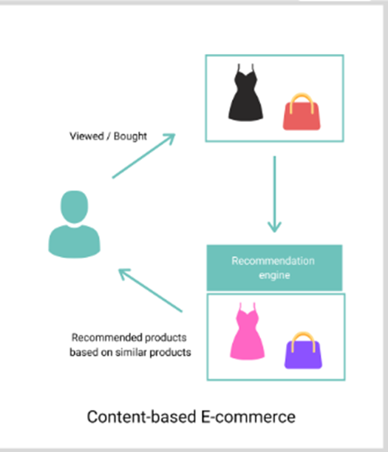
Algorithm used

Slide 8
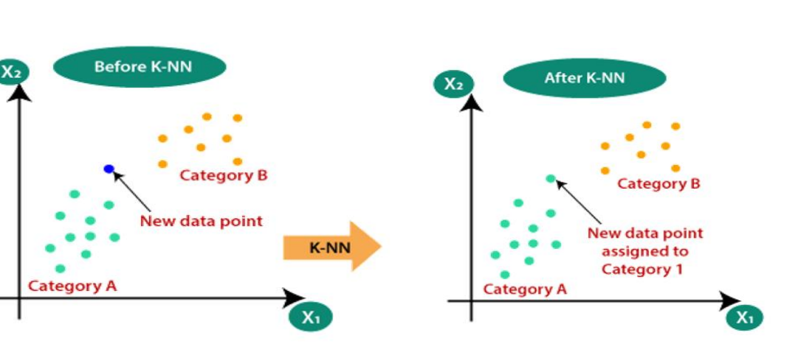
Algorithm used
Demographic Filtering For tackling the problem like cold start (new user with less data) we will use the demographic filtering algorithm. Demographic data based on Location, Age, and Gender.
KNN For handling the gray sheep user problem (users who neither agree nor disagree with the majority group)

Slide 9
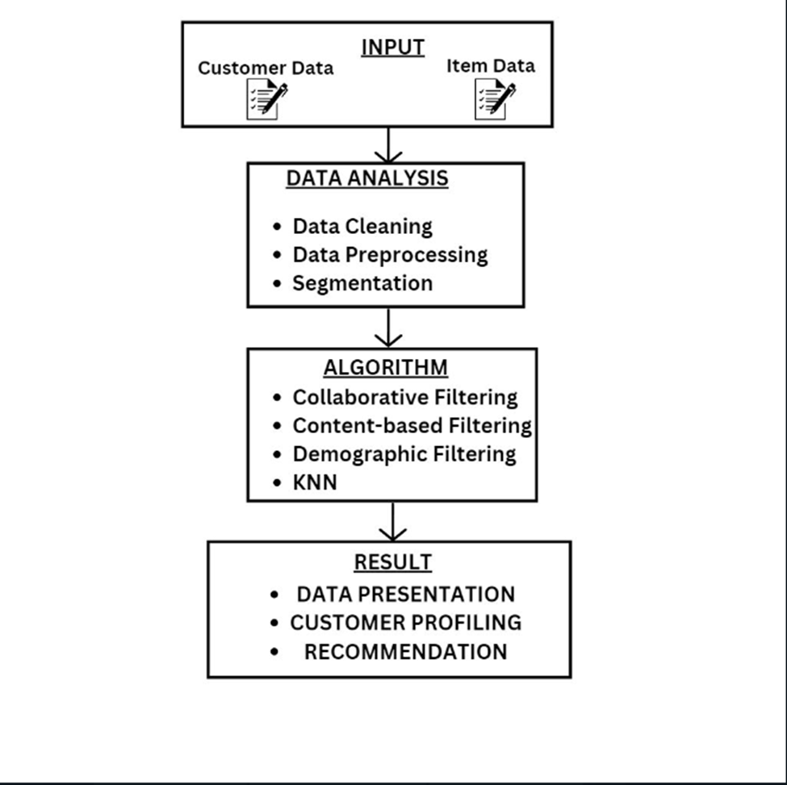
Flow chart of model

Slide 10
Conclusion
By collecting e-commerce user information and data, analyzing and mining e-commerce user data characteristics and shopping records, and according to the analysis results, using appropriate recommendation algorithms to recommend commodities for users, a commodity recommendation system based on e- commerce is realized.

Slide 11

Thank You

